Slide 1
Ridge regression
蒋智超
2025年 秋

Slide 2

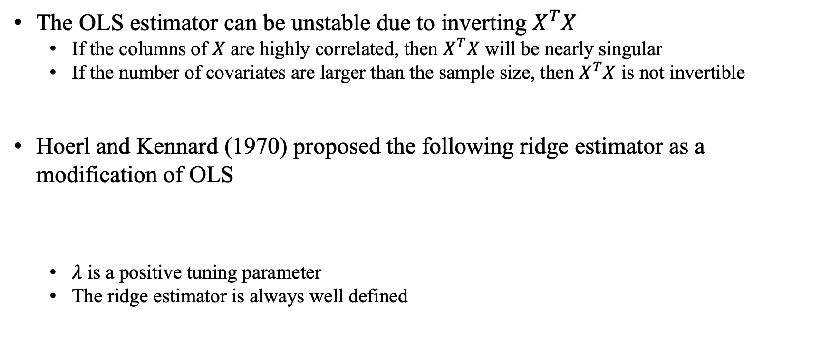
Motivation
The OLS estimator can be unstable due to inverting $X^{T}X$
If the columns of $X$ are highly correlated, then $X^{T}X$ will be nearly singular
If the number of covariates are larger than the sample size, then $X^{T}X$ is not invertible
Hoerl and Kennard (1970) proposed the following ridge estimator as a modification of OLS
$λ$ is a positive tuning parameter
The ridge estimator is always well defined
Notes:
在X不是列满秩的时候很难求逆，或者说X就算是列满秩，列是线性独立的，但是非常接近“线性相关”，所以这个矩阵求逆是非常不稳定的。我们希望改进这个OLS的估计，使得即使X^T X非常接近不可逆的时候，我们的估计依然很稳定，这就是岭回归的最早的思路。最早的岭回归是它加了一个\lambda I_p，\lambda叫做tuning parameter，这个数是在估计的时候选定的，但是我们先假定它给出了。不同的tuning parameter对应不同的\hat{\beta}，我们在实际模型中会去选定\lambda使得这个模型效果最好。我们可以证明只要\lambda>0，(X^T X+\lambda I_p)^{-1}一定是可逆的。

Slide 3
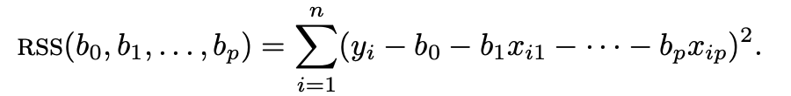
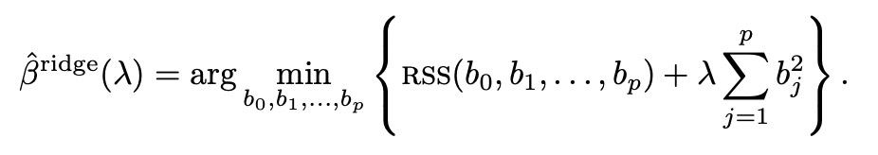
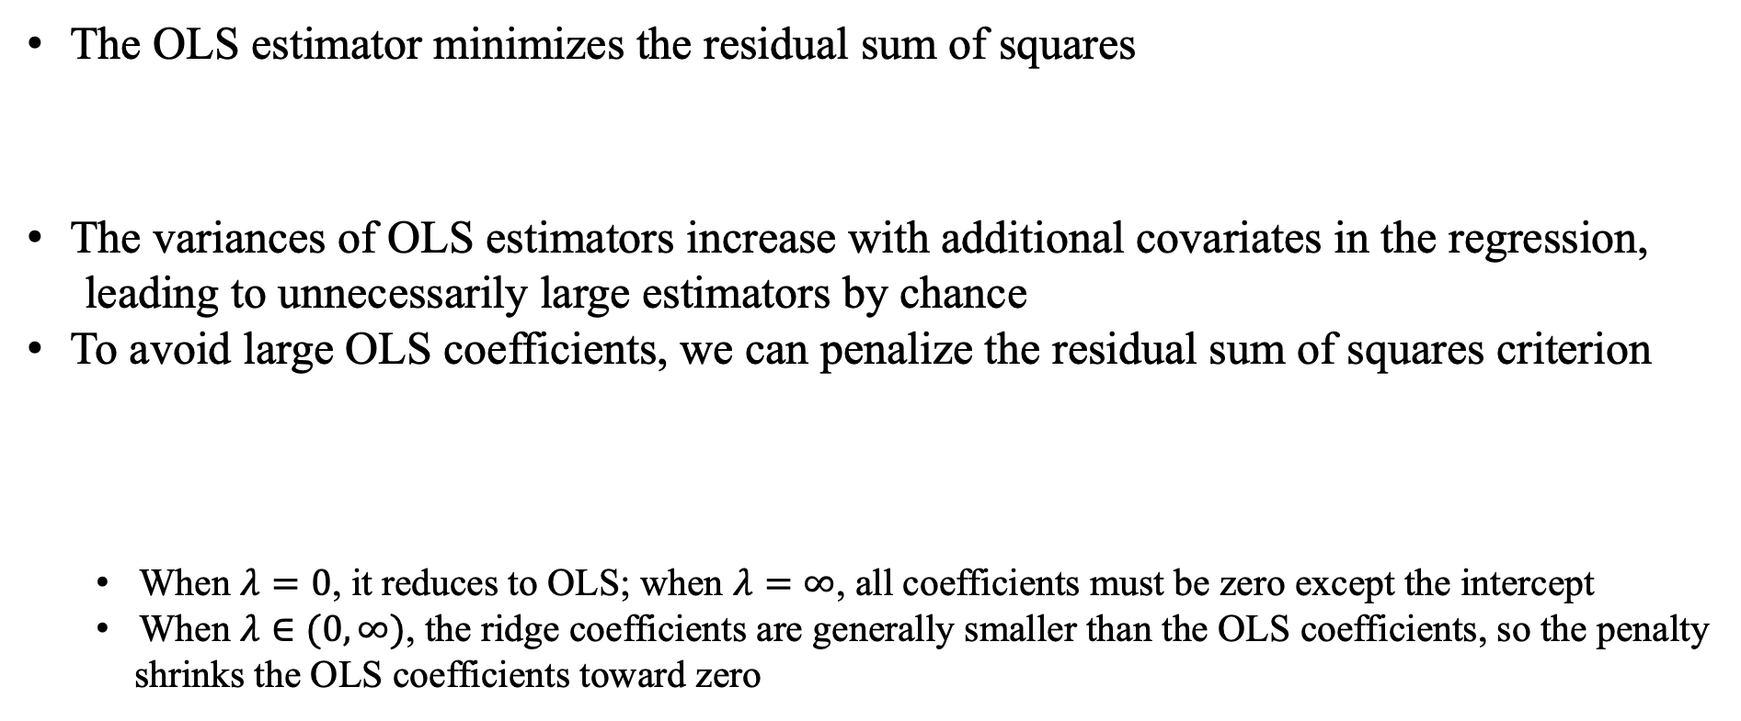
Motivation
The OLS estimator minimizes the residual sum of squares
The variances of OLS estimators increase with additional covariates in the regression,
leading to unnecessarily large estimators by chance
To avoid large OLS coefficients, we can penalize the residual sum of squares criterion
When $λ=0$, it reduces to OLS; when $λ=∞$, all coefficients must be zero except the intercept
When $λ∈(0,∞)$, the ridge coefficients are generally smaller than the OLS coefficients, so the penalty
shrinks the OLS coefficients toward zero
Notes:
我们不对b_0做惩罚，因为截距项是永远出现在回归里面的？中心化处理之后，你会发现，截距项 $b_0$ 根本就没有出现在这个需要惩罚的优化问题里，它只是控制一个上下问题，而不蕴含任何信息和关系。

Slide 4
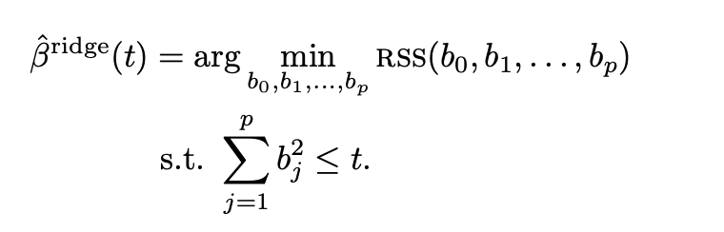
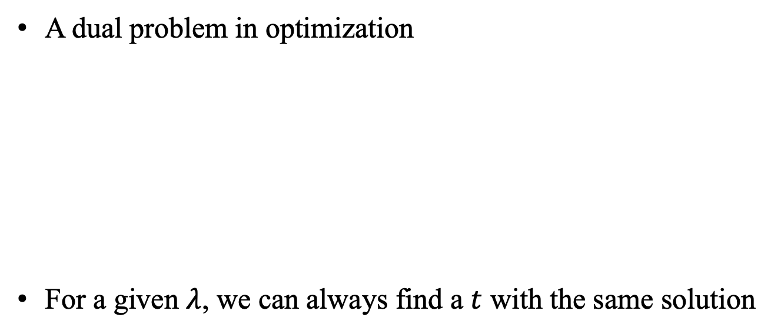
Dual problem
A dual problem in optimization
For a given $λ$, we can always find a $t$ with the same solution

Slide 5

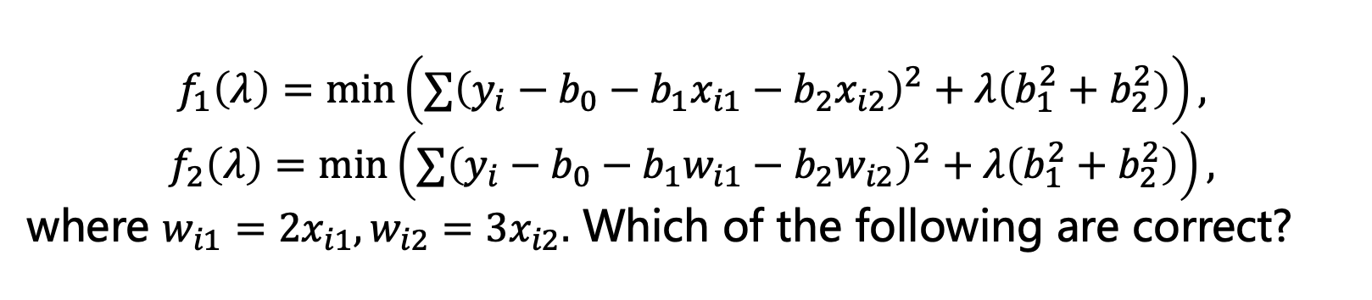
多选题
1分
$$f_{1}\left(λ\right)=\min\left(∑{\left(y_{i}−b_{0}−b_{1}x_{i1}−b_{2}x_{i2}\right)}^{2}+λ\left(b_{1}^{2}+b_{2}^{2}\right)\right),$$
$$f_{2}\left(λ\right)=\min\left(∑{\left(y_{i}−b_{0}−b_{1}w_{i1}−b_{2}w_{i2}\right)}^{2}+λ\left(b_{1}^{2}+b_{2}^{2}\right)\right),$$
where $w_{i1}=2x_{i1}, w_{i2}=3x_{i2}.$ Which of the following are correct?
A
$$f_{1}\left(0\right)=f_{2}(0)$$
B
$$f_{1}\left(0\right)≠f_{2}(0)$$
C
$$f_{1}\left(1\right)=f_{2}(1)$$
D
$$f_{1}\left(1\right)≠f_{2}(1)$$
提交

Slide 6
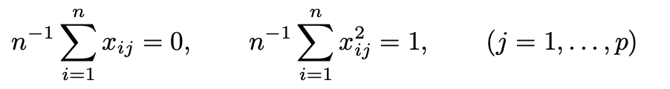

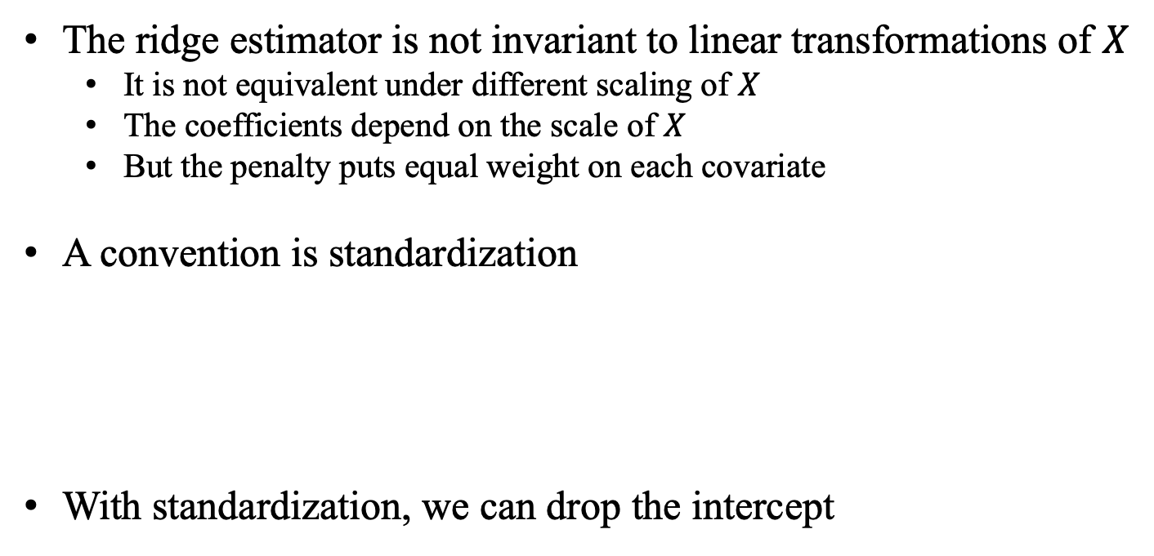
Ridge estimator
The ridge estimator is not invariant to linear transformations of $X$
It is not equivalent under different scaling of $X$
The coefficients depend on the scale of $X$
But the penalty puts equal weight on each covariate
A convention is standardization
With standardization, we can drop the intercept
Notes:
In practical data analysis, the covariates may have concrete meanings. In those cases, you may not want to scale the covariates. However, the results below do not rely on the choice of scaling although it requires centering the covariates and outcome.

Slide 7

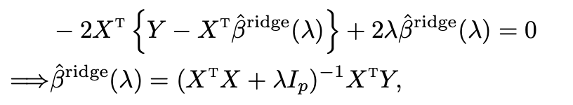

Ridge estimator
Using the matrix form, the ridge estimator minimizes
Predicted vector
Hat matrix
Notes:
when λ > 0, it is not a projection matrix

Slide 8



Ridge estimator
In R, lm.ridge function first computes the ridge coefficient based on the standardized
covariates and outcome, and then transforms them back to the original scale
Means
Standard deviation
Ridge coefficients based on standardized covariates and outcome
Notes:
岭回归为什么叫岭回归？是因为在最小二乘中，有一整条线是最好的，这是不稳定的，就像一个山脊一样，岭回归就是要解决这个问题，加入一个惩罚项，变的圆润一点。

Slide 9

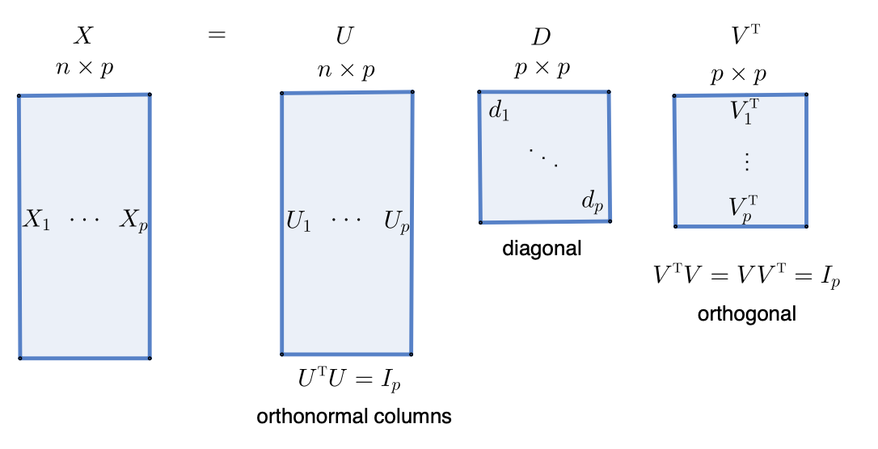

Computation
SVD decomposition of the covariate matrix
Notes:
when λ > 0, it is not a projection matrix

Slide 10
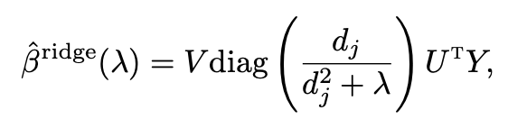
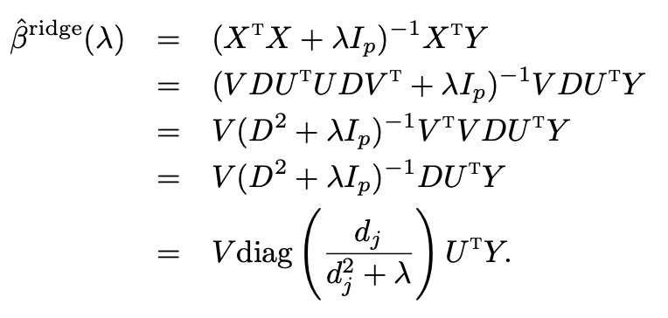
Computation
Proof:

Slide 11
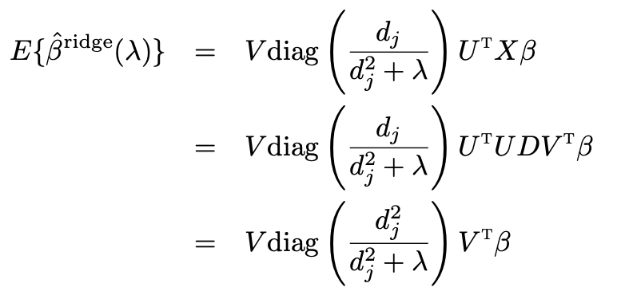
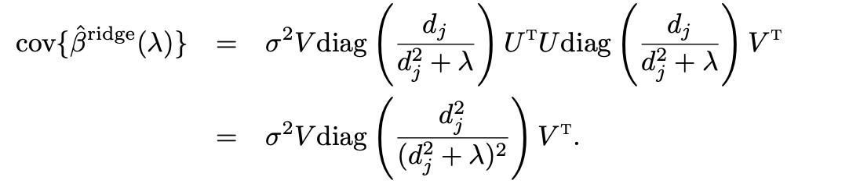
Statistical properties
Can ridge regression improve OLS? (Gauss-Markov model)

Slide 12
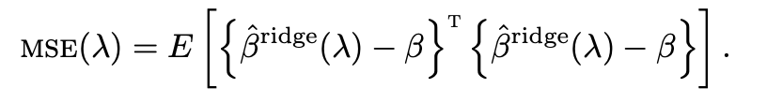
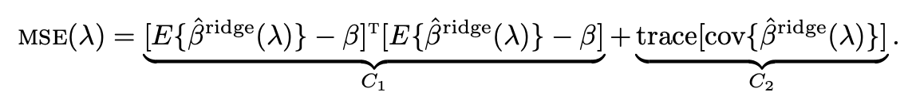
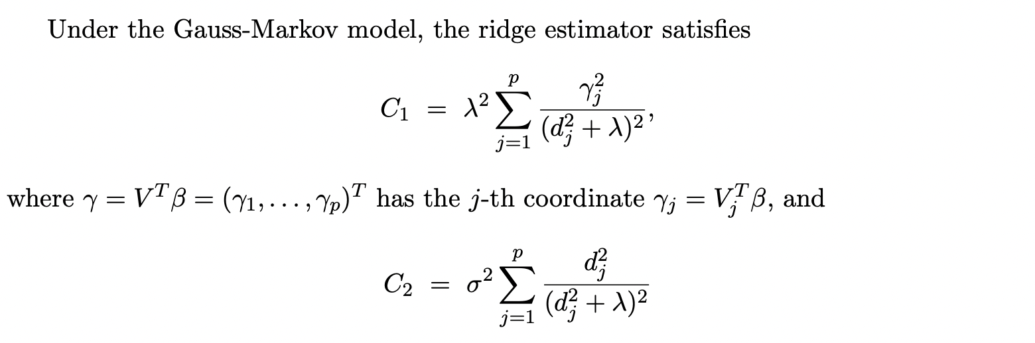
Statistical properties

Slide 13
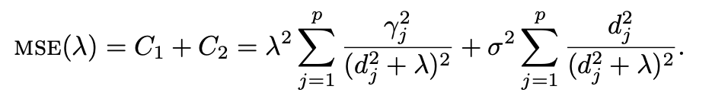
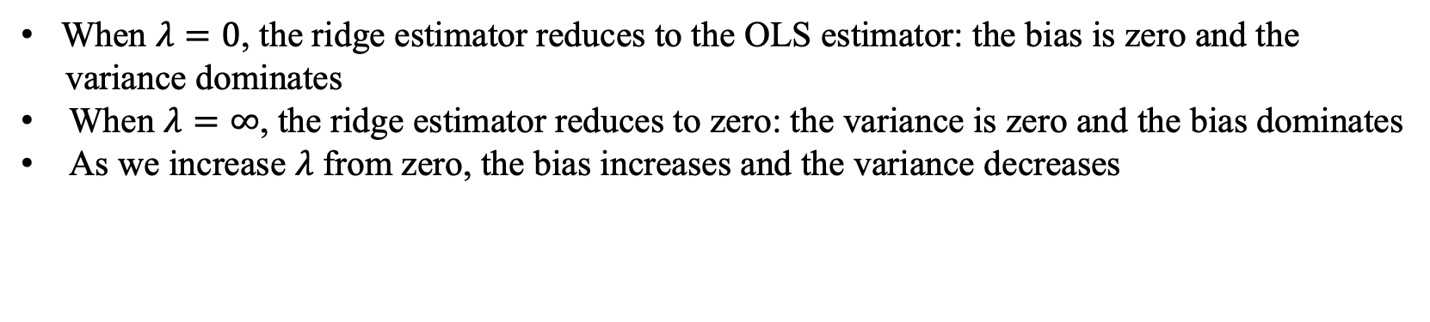
Bias-variance tradeoff
When $λ=0$, the ridge estimator reduces to the OLS estimator: the bias is zero and the
variance dominates
When $λ=∞$, the ridge estimator reduces to zero: the variance is zero and the bias dominates
As we increase $λ$ from zero, the bias increases and the variance decreases
Notes:
Question: can the MSE of ridge estimator be lower than that of OLS?

Slide 14
Selection of the tuning parameter
Based on parameter estimation
Based on prediction

Slide 15
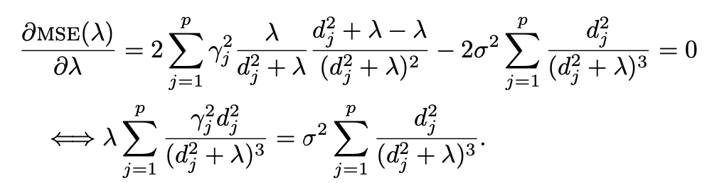
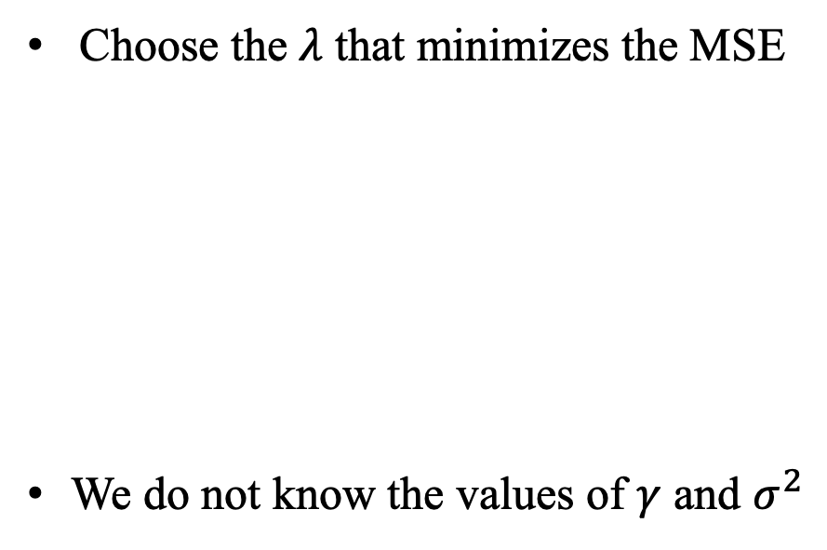
Based on parameter estimation
Choose the $λ$ that minimizes the MSE
We do not know the values of $γ$ and $σ^{2}$

Slide 16
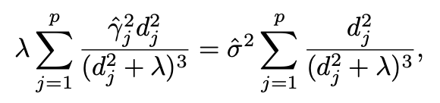
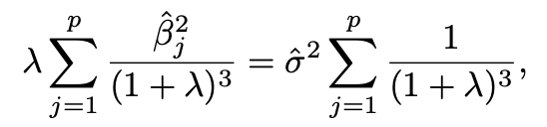


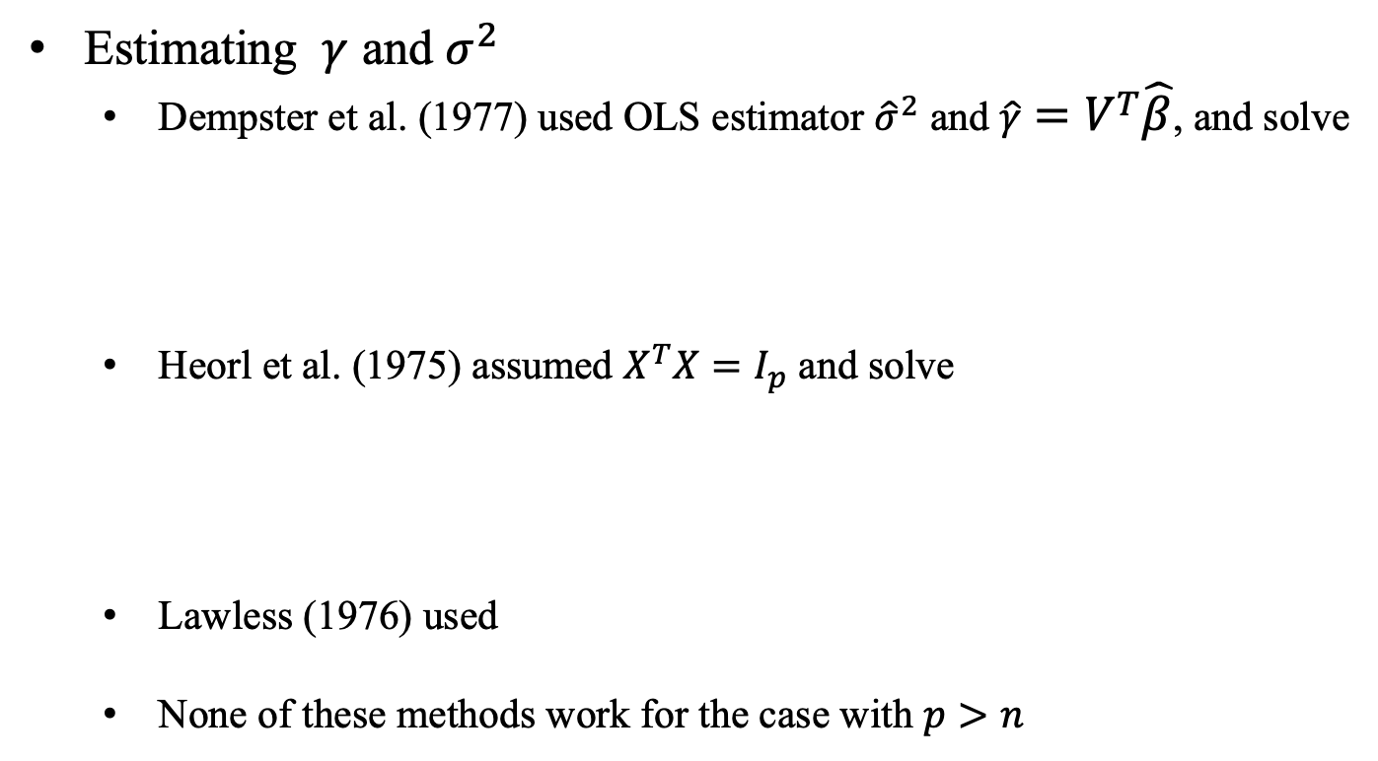
Based on parameter estimation
Estimating $γ$ and $σ^{2}$
Dempster et al. (1977) used OLS estimator ${\hat{σ}}^{2}$ and $\hat{γ}=V^{T}\hat{β}$, and solve
Heorl et al. (1975) assumed $X^{T}X=I_{p}$ and solve
Lawless (1976) used
None of these methods work for the case with $p>n$

Slide 17






Based on prediction
PRESS statistic for ridge regression based on leave-one-out formula
Ridge coefficient
Residual vector
Leverage score
Predicted residual
Leave-one out formulas

Slide 18
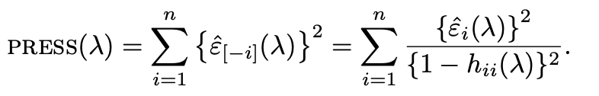
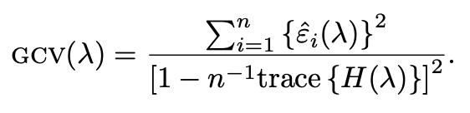
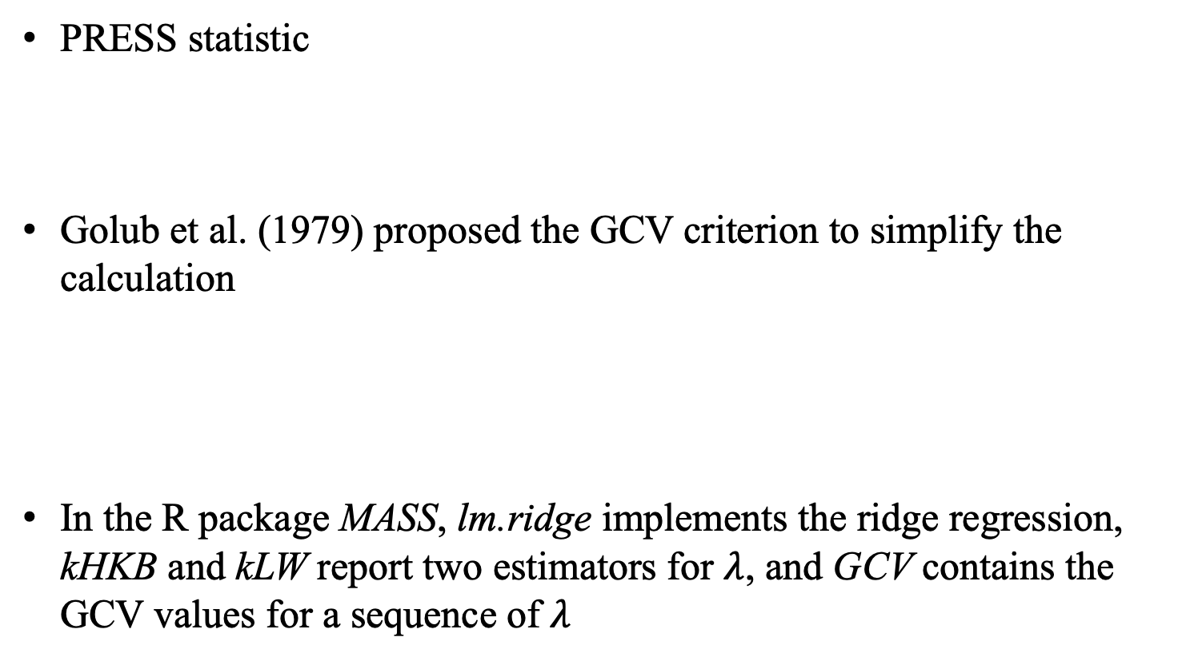
Based on prediction
PRESS statistic
Golub et al. (1979) proposed the GCV criterion to simplify the calculation
In the R package MASS, lm.ridge implements the ridge regression, kHKB and kLW report two estimators for $λ$, and GCV contains the GCV values for a sequence of $λ$

Slide 19
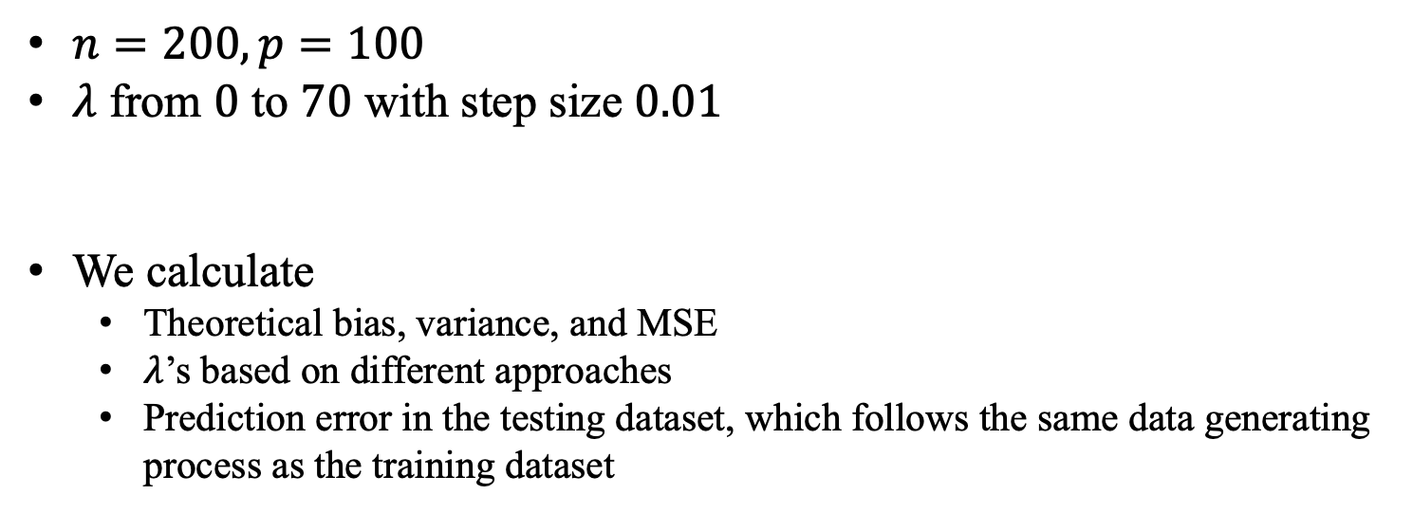
Simulation
$n=200, p=100$
$λ$ from $0$ to $70$ with step size $0.01$
We calculate
Theoretical bias, variance, and MSE
$λ$’s based on different approaches
Prediction error in the testing dataset, which follows the same data generating process as the training dataset

Slide 20
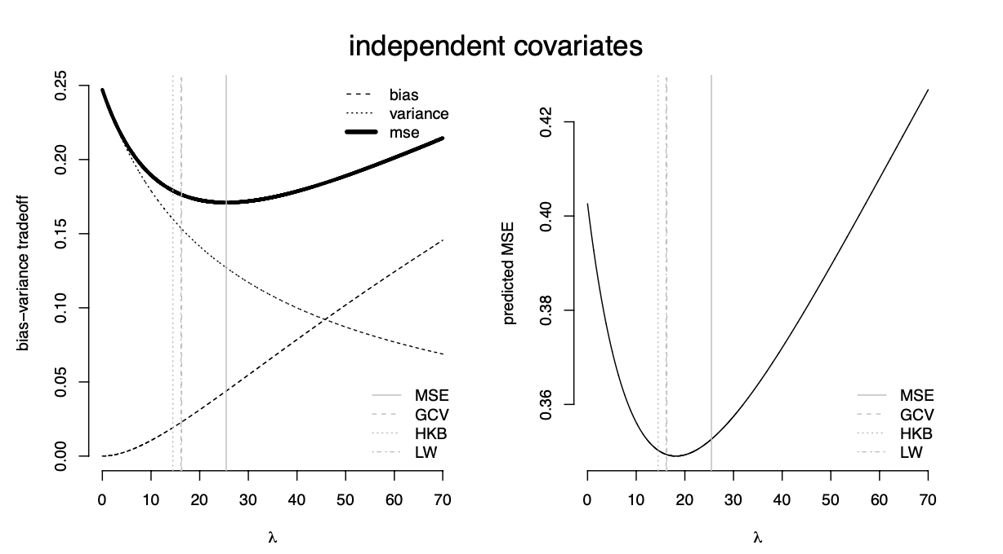
Simulation
Notes:
MSE(\lambda)在0处的导数<0，说明在无偏估计下，MSE取不到最好的结果，带一点偏差反而会好。

Slide 21
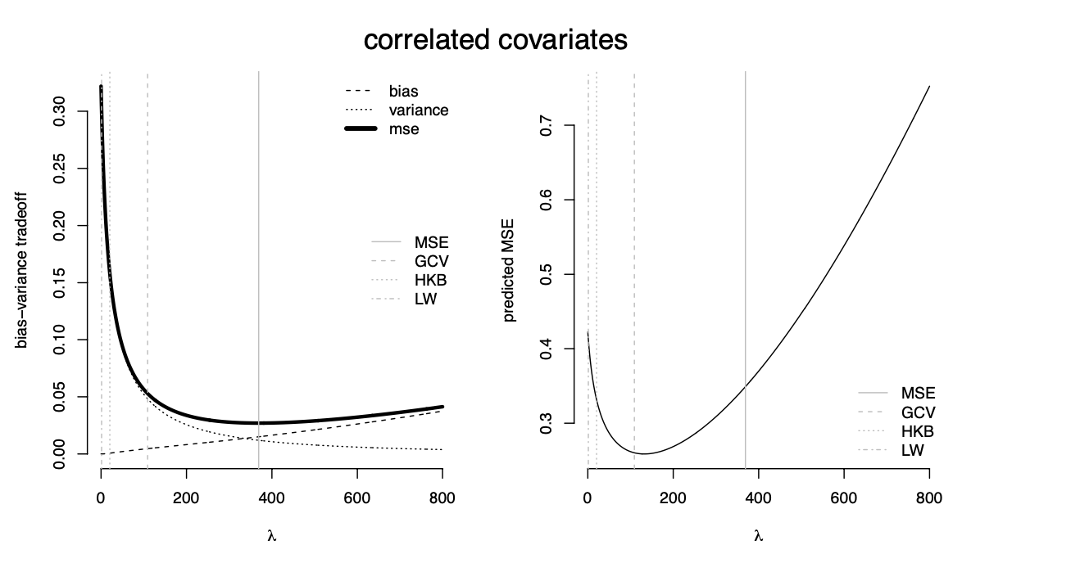
Simulation

